Slide 1
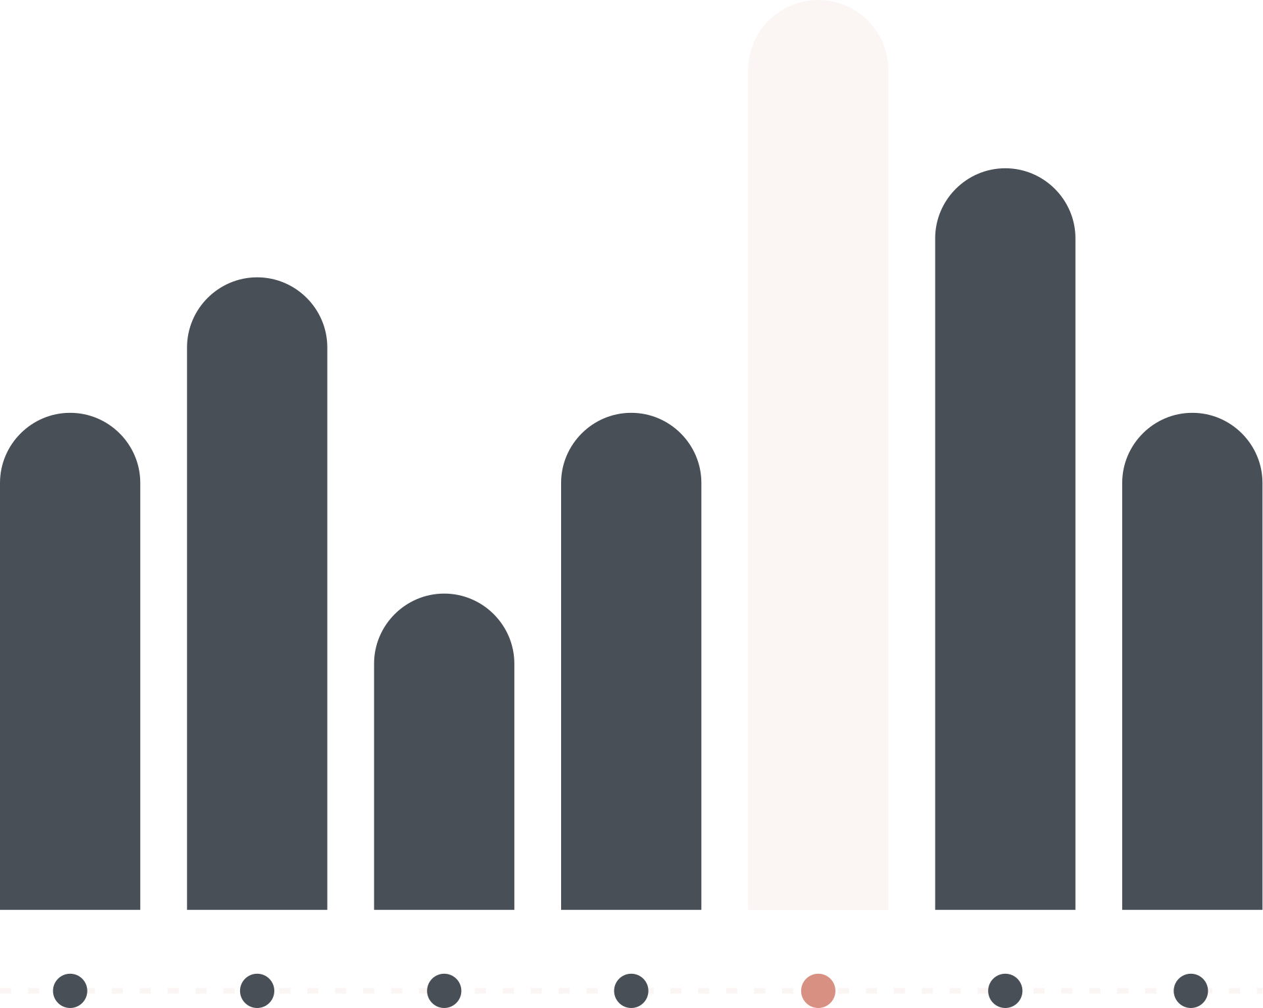

D2C COMPANY
TECHNICAL ANALYSIS

Slide 2
ABOUT THE DATASET
Recency
Numerical
Birth Year
Ordinal Categorical
Marital Status
Categorical
Income
Numerical Continuous

Slide 3
ABOUT THE DATASET
Kids Home/Teens
Numerical
Amount
Numerical Continuous
Website/Social media
Numerical
ID
Unique Identifier

Slide 4






PROJECT LIFE CYCLE
CUSTOMER|SALES
Stage 6
Stage 2
Stage 4
Continued by PBI Analysis
Removing all exceptions
Variate-Proned Analysis
01
02
03
04
05
06
Stage 1
Stage 3
Stage 5
Finding Null Values and Outliers
Descriptive Statistics
Individual Insights Culmination
Analysis by Group: Meenu sree 12214156, Siddharth 12213088, Mehak 12212952, pramod 12215999, sudheer 12216779

Slide 5

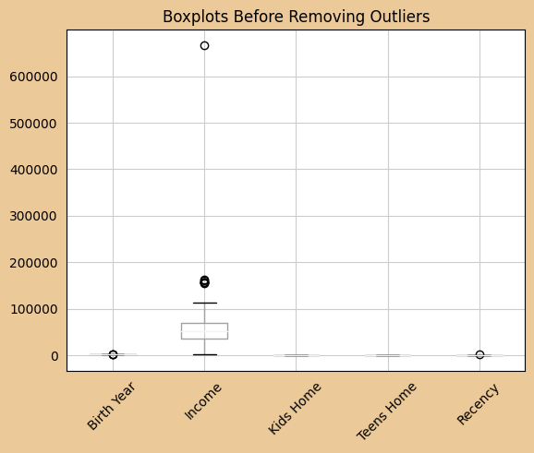
Finding Outliers
We found OUTLIERS in the INCOME field of CUSTOMERS subsheet.

Slide 6
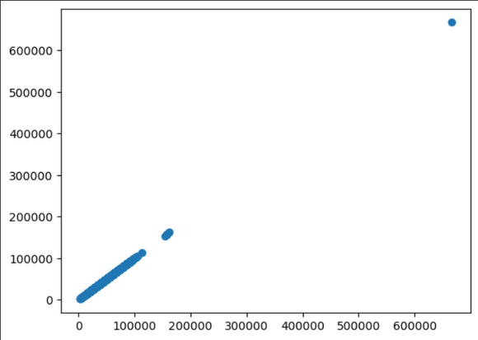
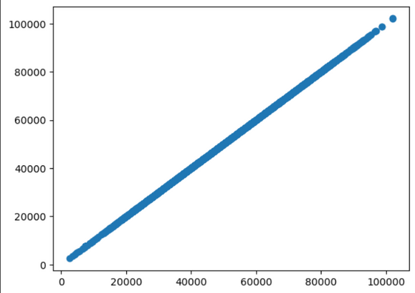
WITH OULIERS
Removal of Outliers
Used IQR method remove outliers:
Lower_bound = Q1 - 1.5 * IQR
Upper_bound = Q3 + 1.5 * IQR
Outliers = (df < lower_bound) | (df > upper_bound)
AFTER REMOVING OUTLIERS

Slide 7

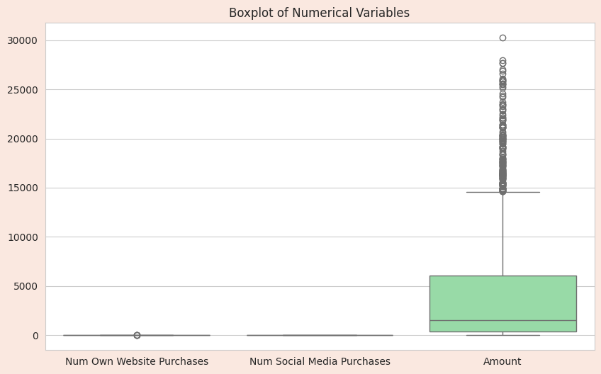
Finding the Ouliers...
We found out OUTLIERS in the AMOUNT filed within SALES subsheet

Slide 8
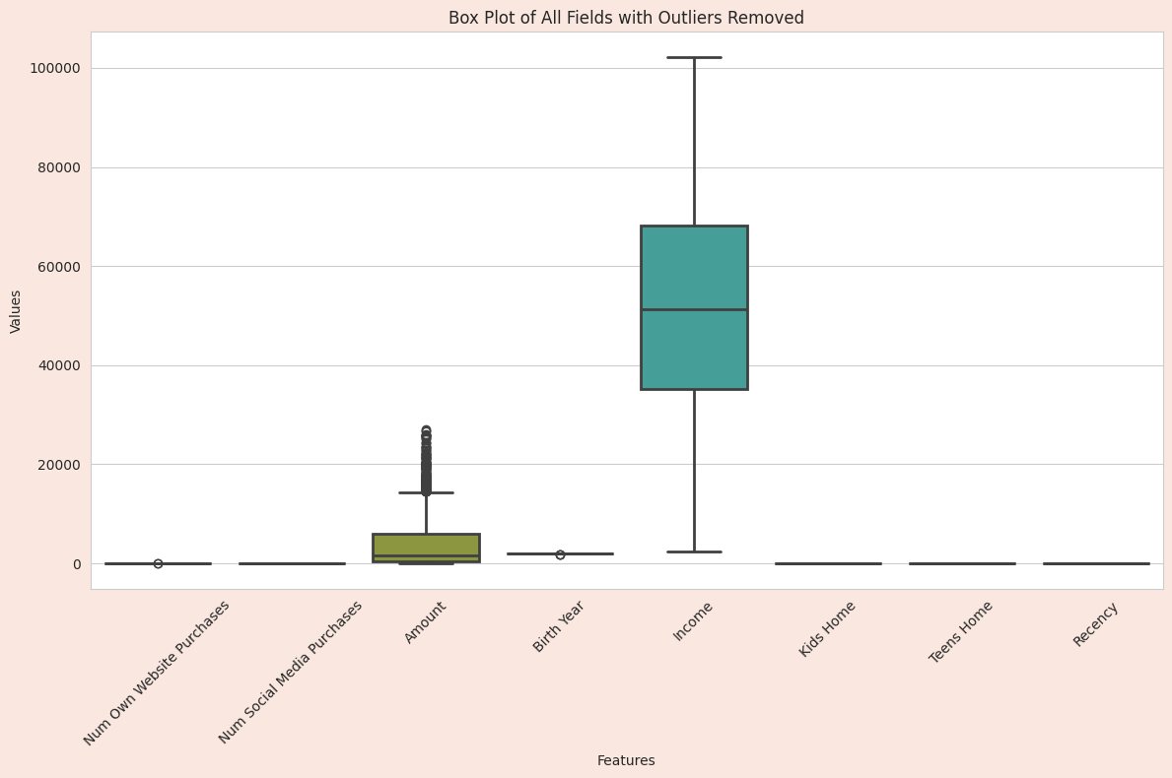
After Outlier Removal
We used the IQR Limit to eliminate the outliers.
We used PANDAS library to remove the outliers.

Slide 9
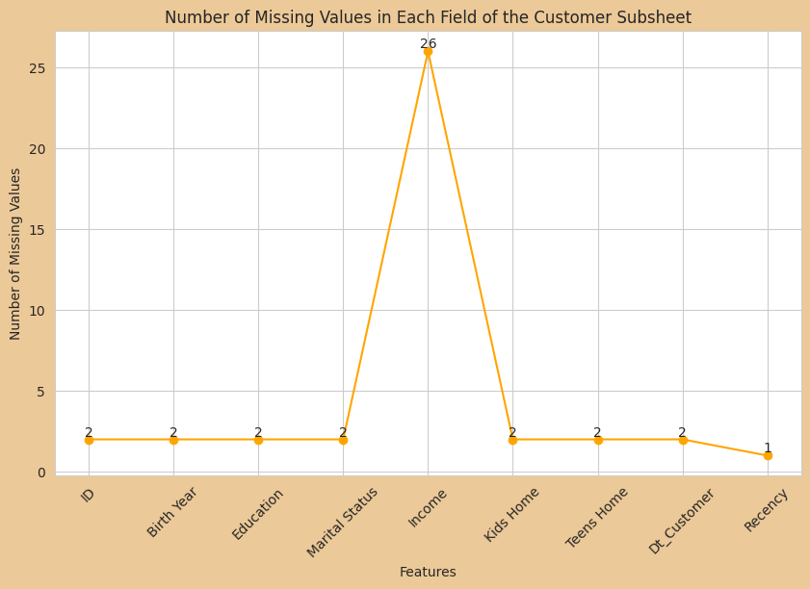
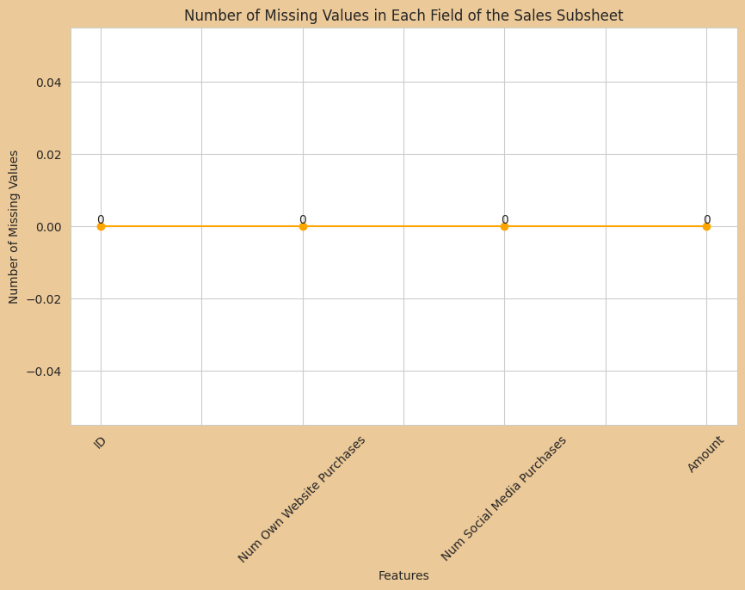
Handling Null Values

Slide 10


Used dropna() method to remove the null values
Null Values Mitigation

Slide 11
Descriptive Statistics
For INCOME field
Metric | Value | Means
Mean | 51622.08 | Average Income
Median | 51287.0 | Middle Value
Mode | 7500 | Repeated value
IQR | 33085.0 | [25% to 75%]
Metric | Value | Means
Variance | 4.2*10^9 | Measure of spread
StandardDeviation | 20713.0638 | Dispersion measure
Skweness | 0.013 | Asymmetry measure
Kurtosis | -0.84836 | Peakness measure

Slide 12
Cont......
For Amount Field
Metric | Value | Means
Mean | 4226.08 | Average amount
Median | 1520 | Middle Value
Mode | NA | Repeated value
IQR | 5680.0 | [25% to 75%]
Metric | Value | Means
Variance | 3.1*10^8 | Measure of spread
StandardDeviation | 5653.71 | Dispersion measure
Skweness | 1.69 | Asymmetry measure
Kurtosis | 2.23 | Peakness measure

Slide 13
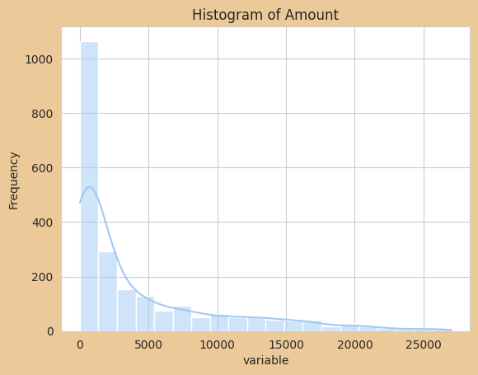
Univariate Analysis
From hereon we are using Matplotlib and Seaborn libraries.
MATPLOTLIB:Plotting Lib
SEABORN:Highlevel Interface

Slide 14
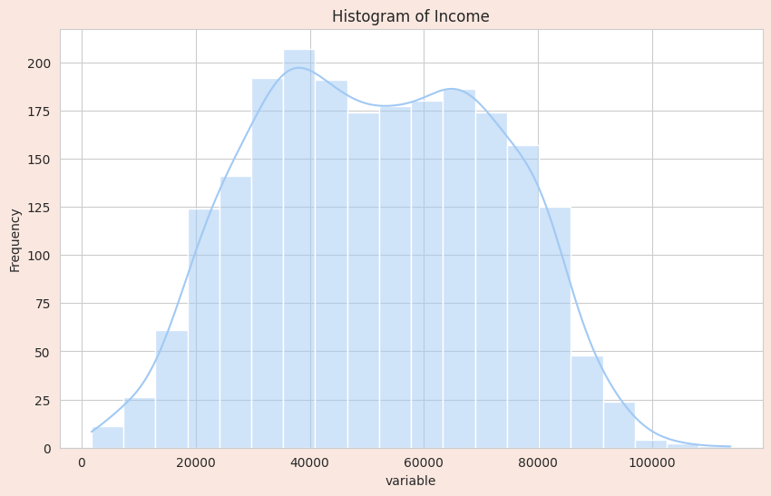
Histogram of Income
Revelations-Insights
1.No skewness or Kurtosis
2.Got ridoff Ouliers
3.Checked Data Quality

Slide 15
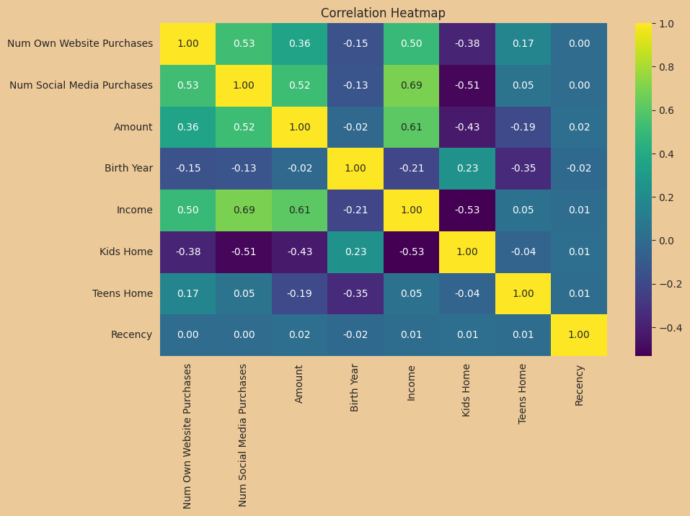
Correlation Heatmap
Key Insights:
1.Income and Kids: -ve Correlation
2.Income and social media : +ve Correlation
3.Amount and Kids : -ve Correlation

Slide 16
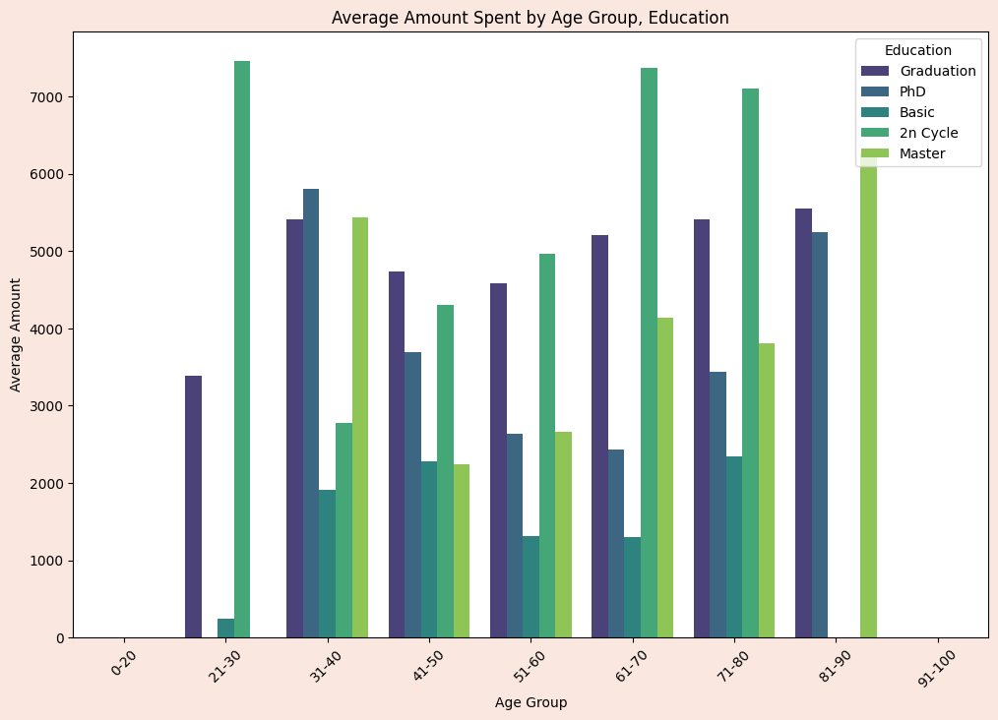
Amount Spent VS Age Groupby Education
Revelations-Insights
Young Adults: Graduation
Middle-Aged Adults:2n
Senior Adults:2n and Masters

Slide 17
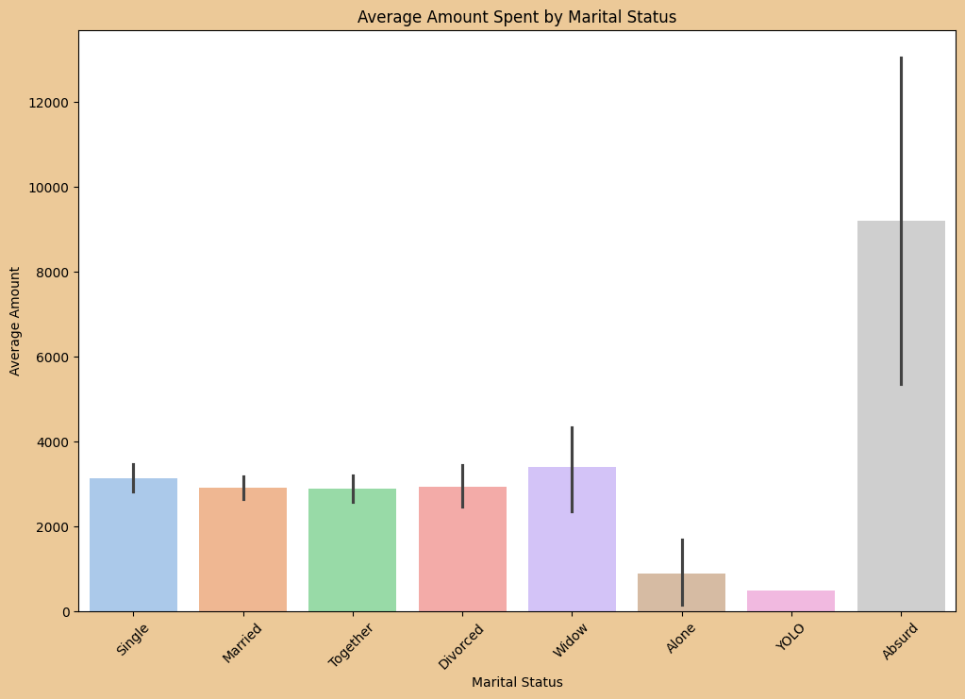
Amount vs Marital Status
Key Insights:
(Absurd) section of people are spending more money and targetted audience for bulk and flagship sales.

Slide 18
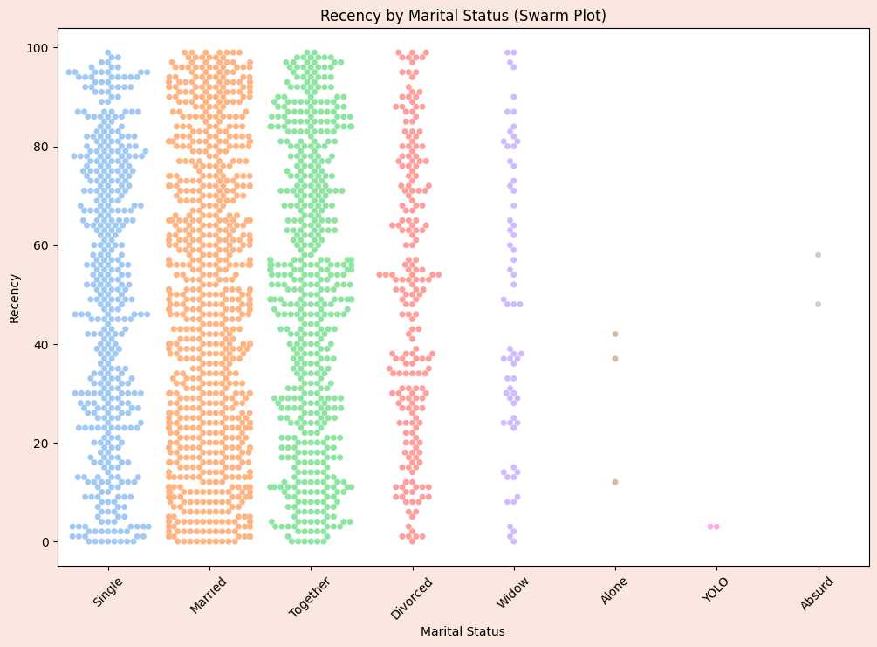
Recency vs Marital Status
Revelations-Insights
1.In backlash to the previous plotting,the recency of ABSURD people is quite high.

Slide 19
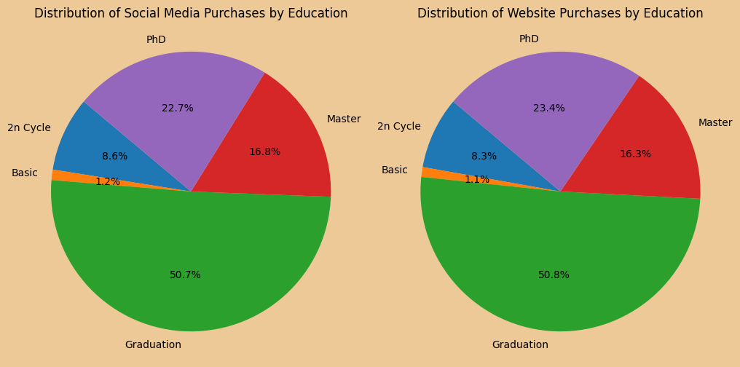
Similarity in the distribution of Customers(Literary)

Slide 20
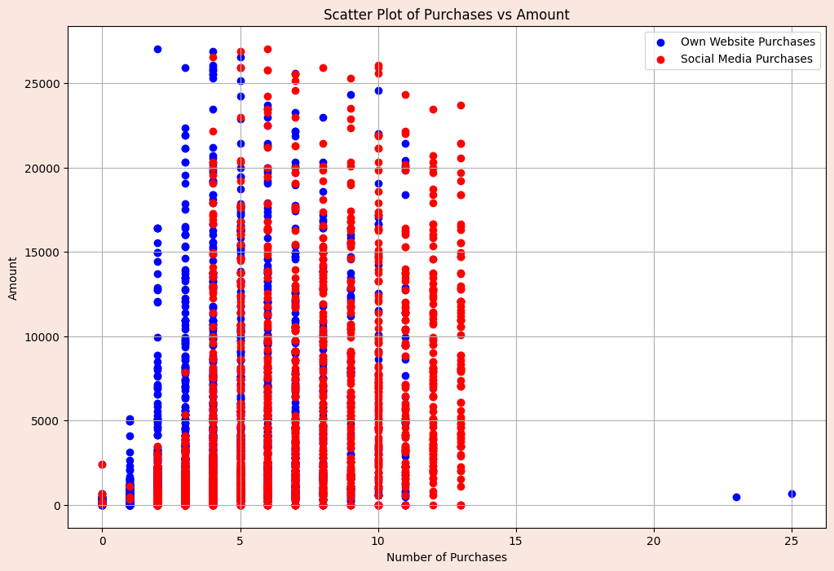
Purchases VS Amount
Revelations-Insights
Highest frequency of orders are being made from social media purchases.

Slide 21
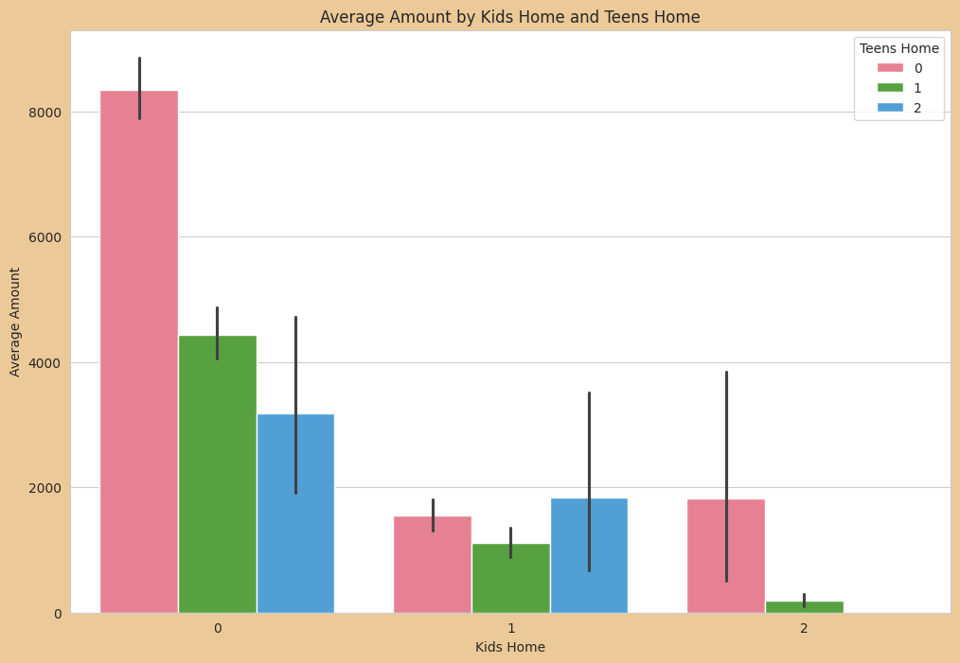
Amount vs Kids home(grouped by TEENS)
Key Insights:
Households with no kids are spending much Amount and TEENS increment also decreases the Amount

Slide 22
GRAPH INTERPRETATION
1. Negative Correlation between Amount Spent and Number of Children at Home
2. Increasing Income Linked to Higher Social Media Purchases
3. More Children at Home Associated with Lower Income Levels
4. Spending Patterns Based on Education Level
5. Absurd Section Spending Behavior
6. Similar Distribution of Social Media and Website Purchases Across Education Levels

Slide 23


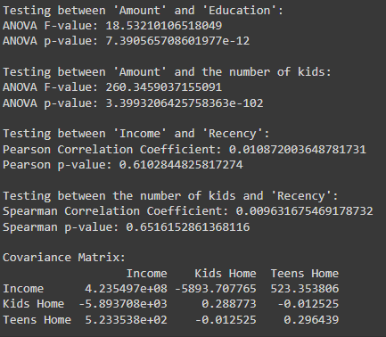
YES / NO
03
TESTIBG

Slide 24
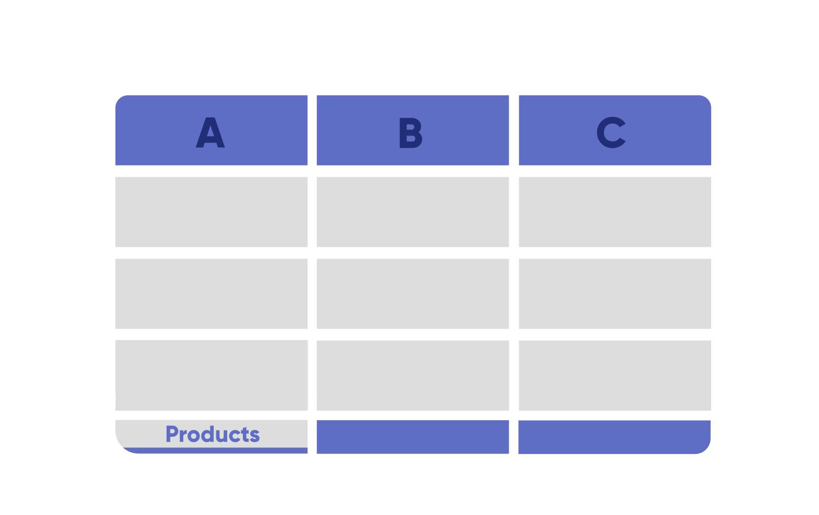
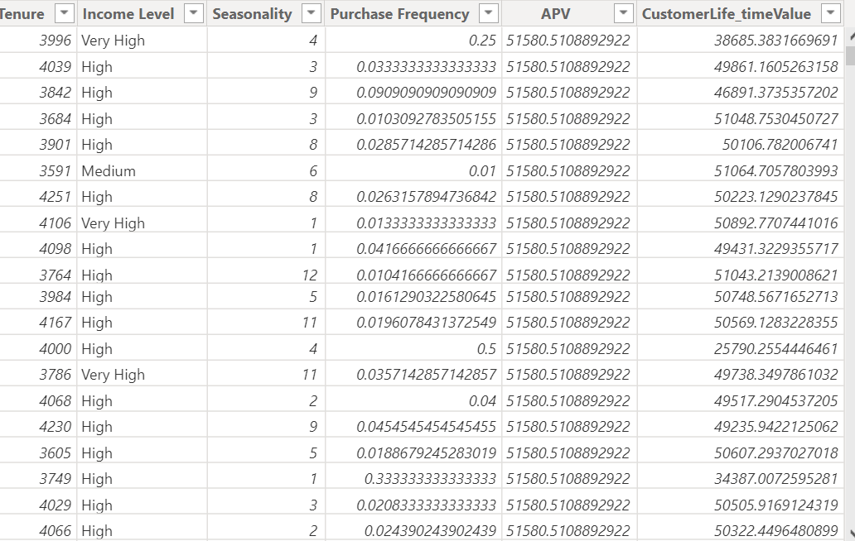
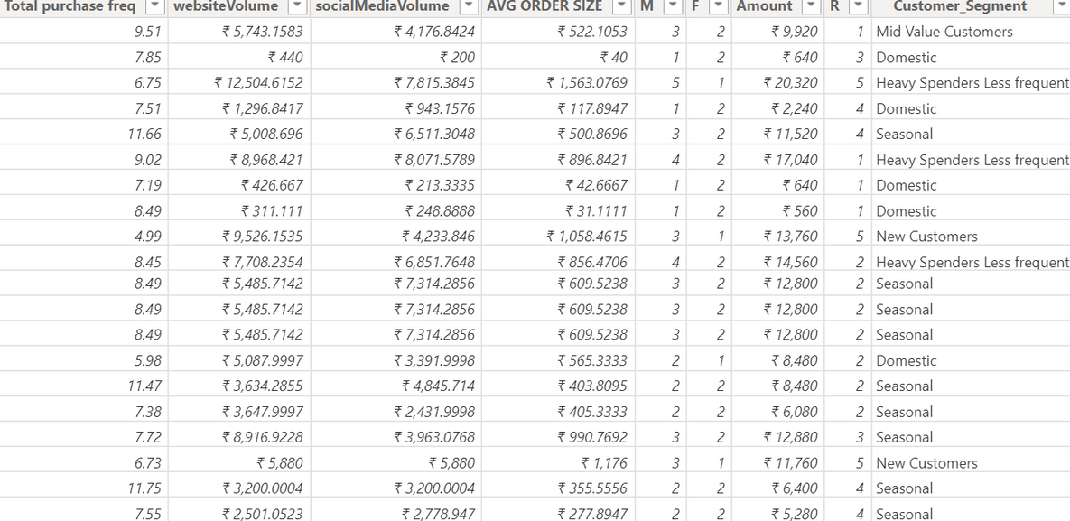
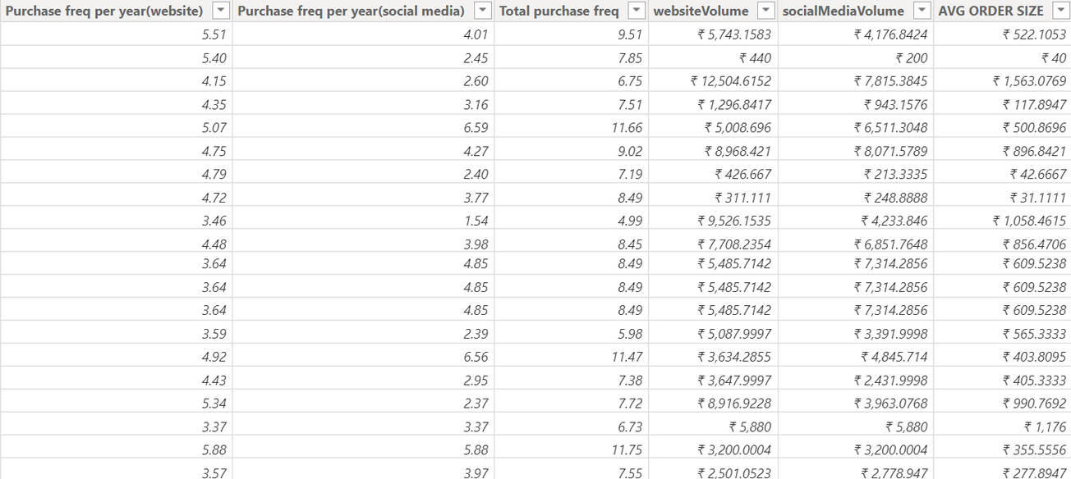
Adding new required columns for better understanding and visualizations

Slide 25
New columns and measures:
AOF (Average Order Frequency):
Total purchases / Number of customers
AOS (Average Order Size):
Total Amount / Total purchases
ACV (Average Customer Value):
AOS *AOF
ACL (Average Customer Lifetime):
Customer Lifetime/ Number of customers
CLV(Customer Lifetime Value):
ACL *ACV
Adjusted amount:
New amount column where amount =0 is replaced with AOS * Number of purchases
Customer Lifetime(in years):
[ (Number of days from First purchase date to the date of analysis)-Recency]/365
Total Purchase Frequency:
Total purchases by customer/Customer lifetime

Slide 26
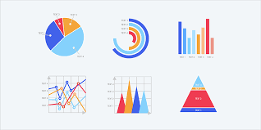
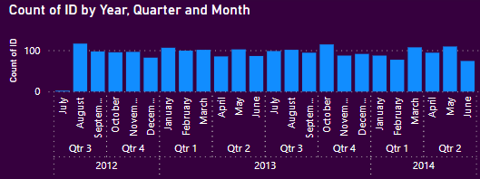
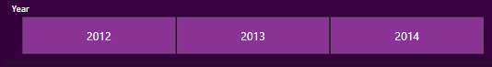
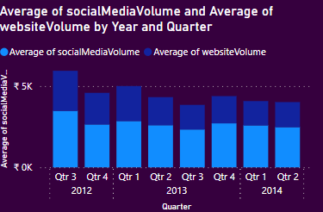
Analyzing the count of IDs over time, broken down by year, quarter, and month.
This visualizations provide the distribution of IDs over time, analyzing the trends and patterns at different levels of granularity.
Average number of social media interactions and website visits, respectively, grouped by year and quarter.
The average amount of purchase on social media and website during specific time periods.
Social media marketing efforts ,Monitoring trends and changes in customers

Slide 27
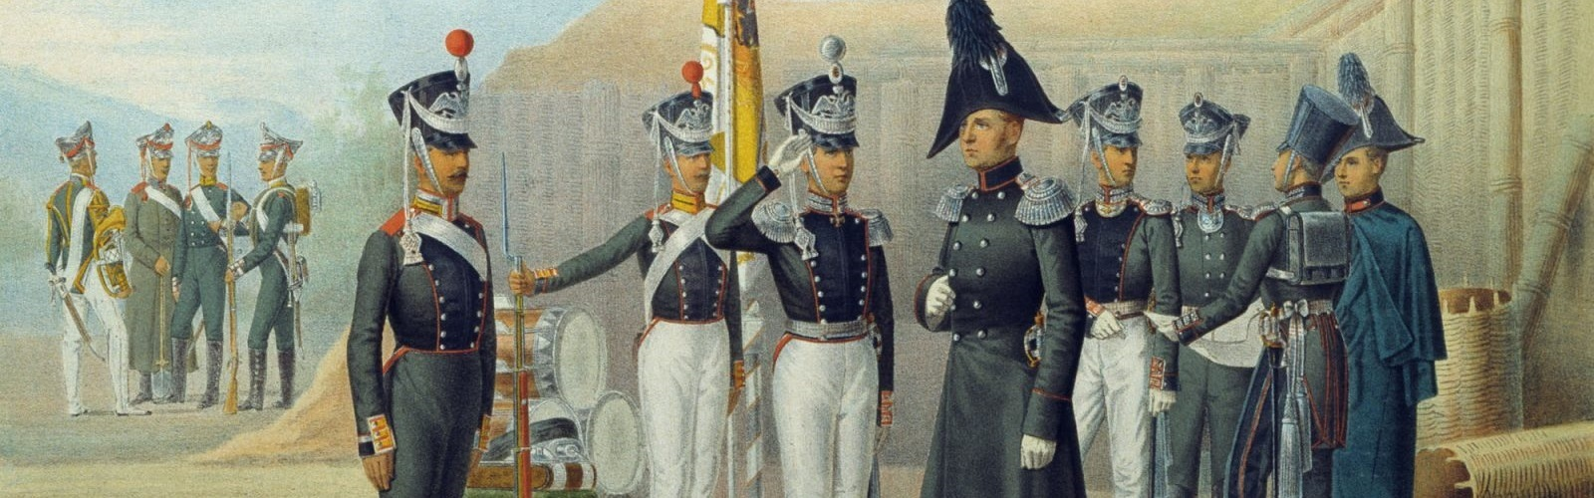
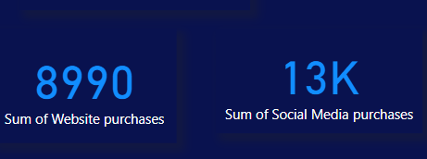
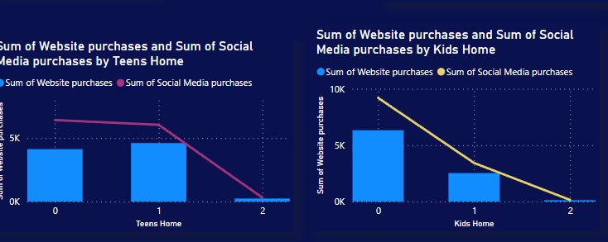
KPI cards for total social media and website purchases
Monitoring the ROI(Return on investment) of social media marketing.
Comparing the total website purchases with other channels and analyzing the impact of website updates, promotions, user experience.
The total social media and website purchases based on the presence of teens and kids
Marketing efforts by comparing the total social media and website purchases between customers with and without teens and kids

Slide 28
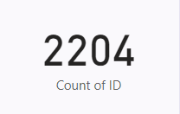
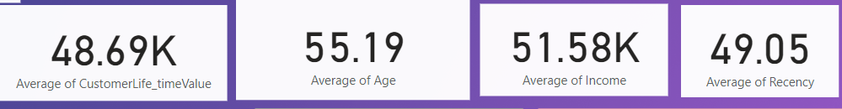
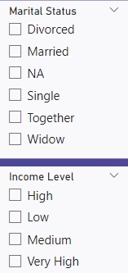
Different Key Performance Indicators are used for performance measurement
Various Slicers were used to filter the data based on Martial status and Income Level

Slide 29
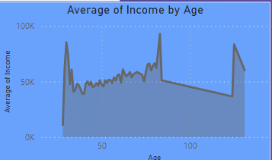
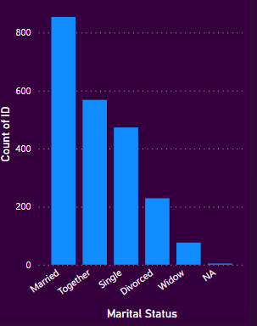
The average income for each distinct age value in the dataset.
Understanding the income distribution among different age groups
Different pricing tiers and product pricing and positioning Strategies
The count of IDs grouped by marital status
Martial Status influences customer lifetime value and purchasing behavior. Company can develop products nedds of specific martial groups
Market expansion according to the significant population in a particular area and cater according to the demographic

Slide 30
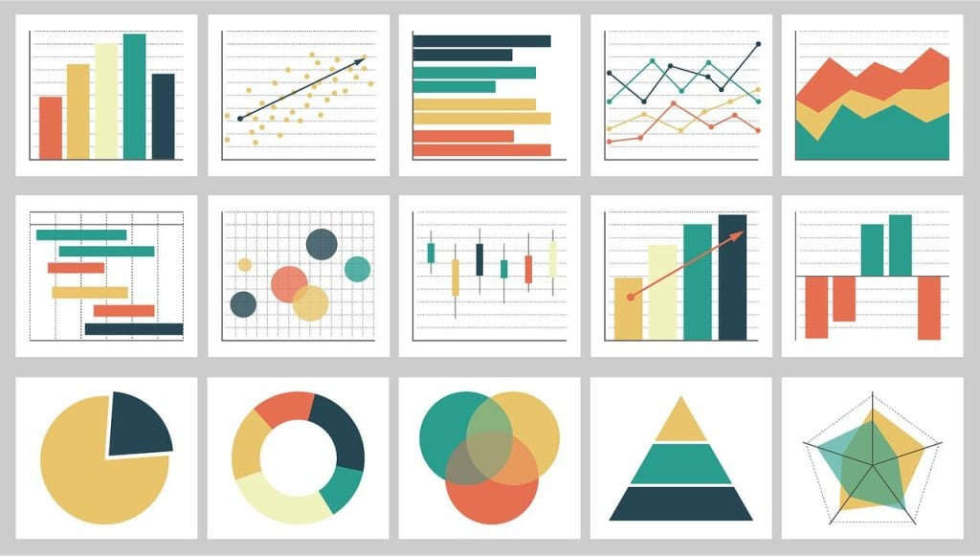
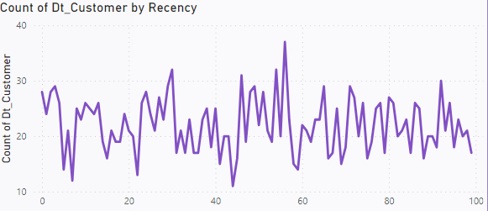
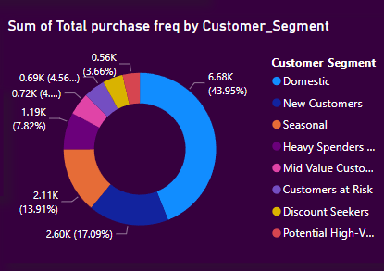
This analysis helps to understand the distribution of customer activity over time and frequency of interactions
This visualization helps us to understand the distribution of customers based on how recently customers are engaged with the company business
The total purchases frequency across different customer segments.
Customers are segmented based on RFM(RECENCY, FREQUENCY ,MONETRAL VALUE) scores
This visualization helps the company purchasing patterns of different customer segments

Slide 31
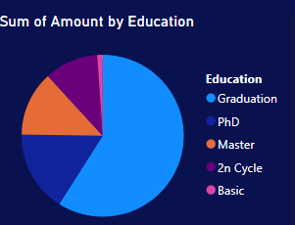
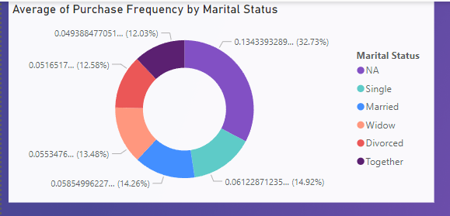
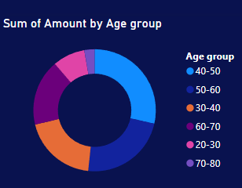
Total Amount according to the education level
Graduation students purchasing the company products more.
Customer segmentation, price sensitivity like analyzing spending patterns and responses to pricing changes
The average purchase frequency across different marital status categories.
Total amount of purchases made by customers grouped into specific age ranges.

Slide 32
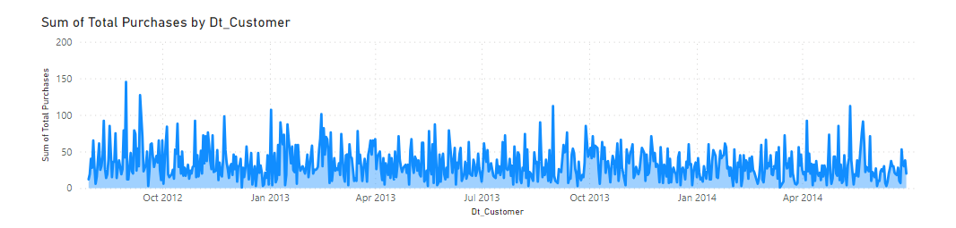
The total amount of purchases made by customers, grouped or aggregated by the date when each customer was acquired
Sales Performance Monitoring like whether sales are growing ,declining or remaining stable, Timely adjustments to marketing strategies
Inventory management like understanding and timings and volume of purchases, Minimizing stockouts
It shows how much revenue was generated from purchases made by customers who were acquired on a particular date. This measure helps analyze the effectiveness of customer acquisition efforts over time and can provide insights into customer behavior trends based on the timing of their acquisition.

Slide 33

Conclusion
Performance Monitoring : Timely adjustments to strategies and tactics to capitalize on emerging opportunities
Segmentation and Targeting : By segmenting customers based on education level, marital status, and age. Company can sustain its marketing efforts and product offerings to specific customer segments
Targeted approach increases the relevance of marketing campaigns and enhances customer engagement, leading to higher conversion rates and customer satisfaction.
Optimized Marketing Strategies : Analyzing purchase behavior over time and identifying seasonal trends enables the company to optimize its marketing strategies

Slide 34
New Product Launch : Launch of new products by identifying target customer segments most likely to be interested in the offering
Continuous Improvement: Visualizations serve as a foundation for continuous improvement and optimization of business strategies
Customer feedback and Informed Decision Making

